Slide 1
Lens Update: Parameter Scan, Double Lens
YbOH/CaOH Subgroup Meeting
Thursday, September 3, 2020

Slide 2
Outline
Halbach cylinder as magnetic lens
Positioning
Tune-Ups
Double Lens
WIPs

Slide 3
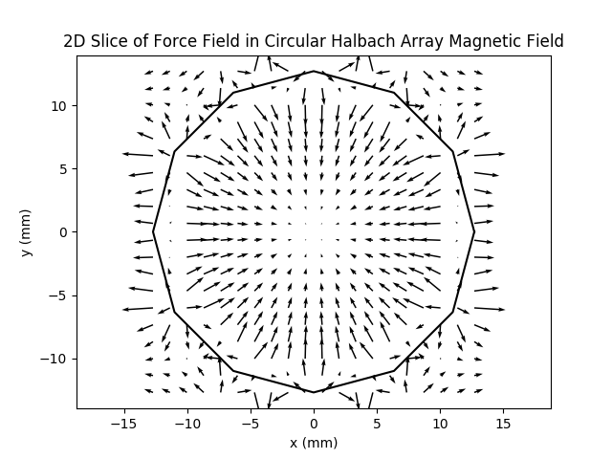
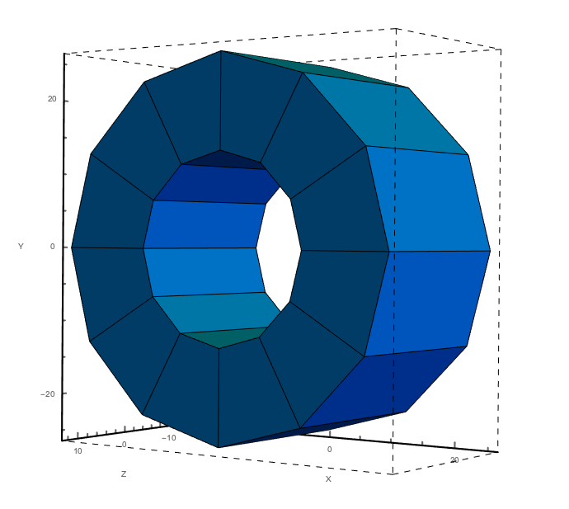
Halbach Cylinder
Inner bore radius: 12.5 mm, outer radius: 25.4 mm
Axial length: 25.4 mm
k = 4

Slide 4
Experimental Setup: Single Lens
4K Aperture,
1 cm
Beam Shutter,
1.4 cm
2.54 cm
Cell
10 cm
Varied
Lens
32 cm
MOT Region

Slide 5
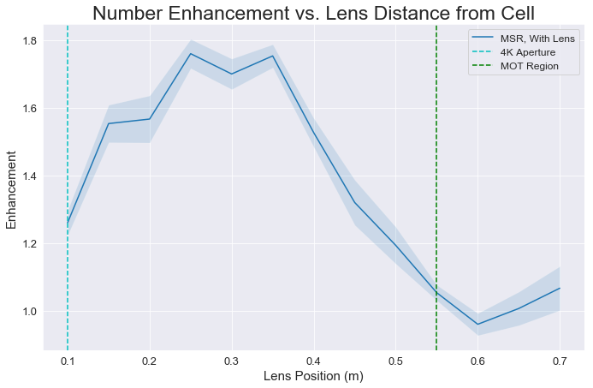
Parameter Scan
Yield ratio peaked when lens situated about 30 cm from cell aperture

Slide 6
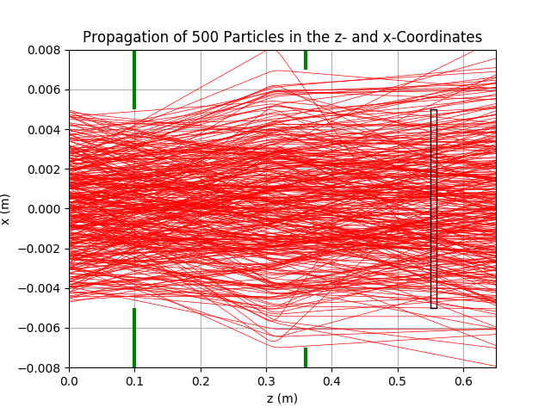
Parameter Scan

Slide 7
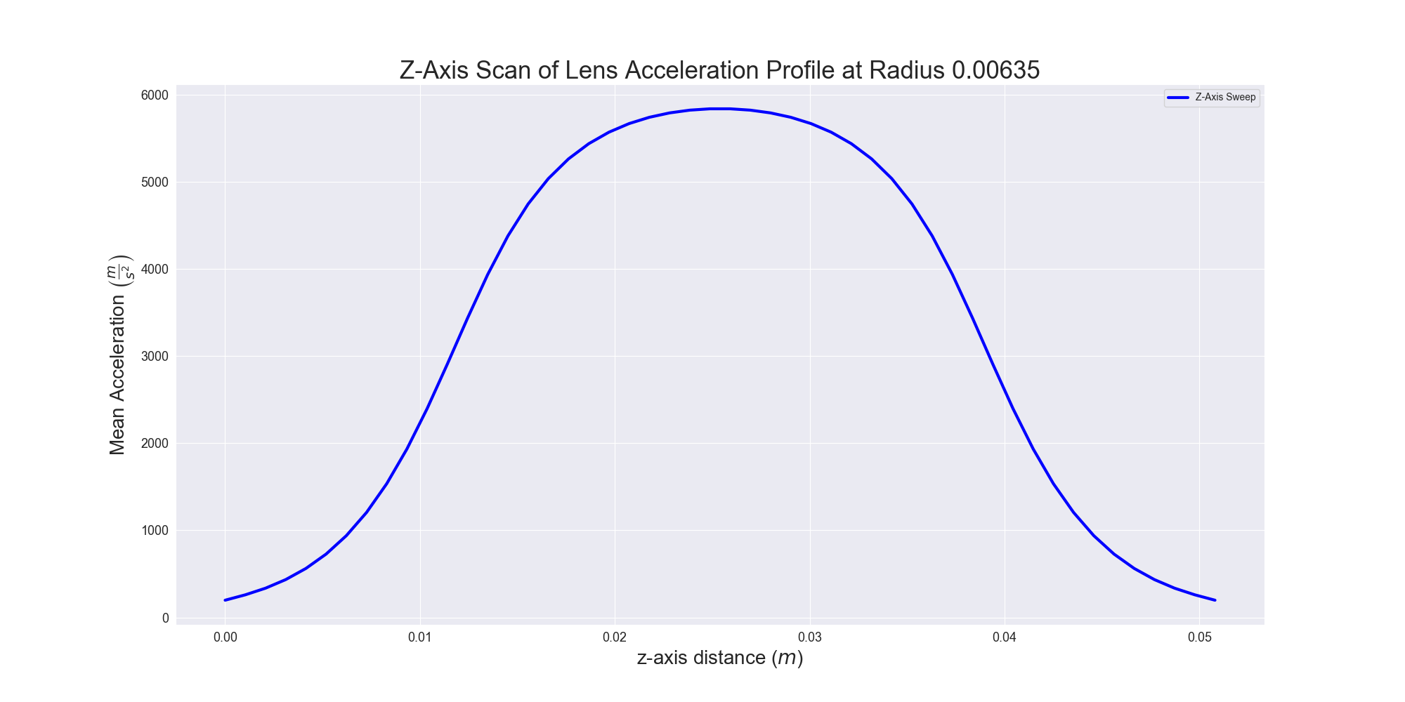
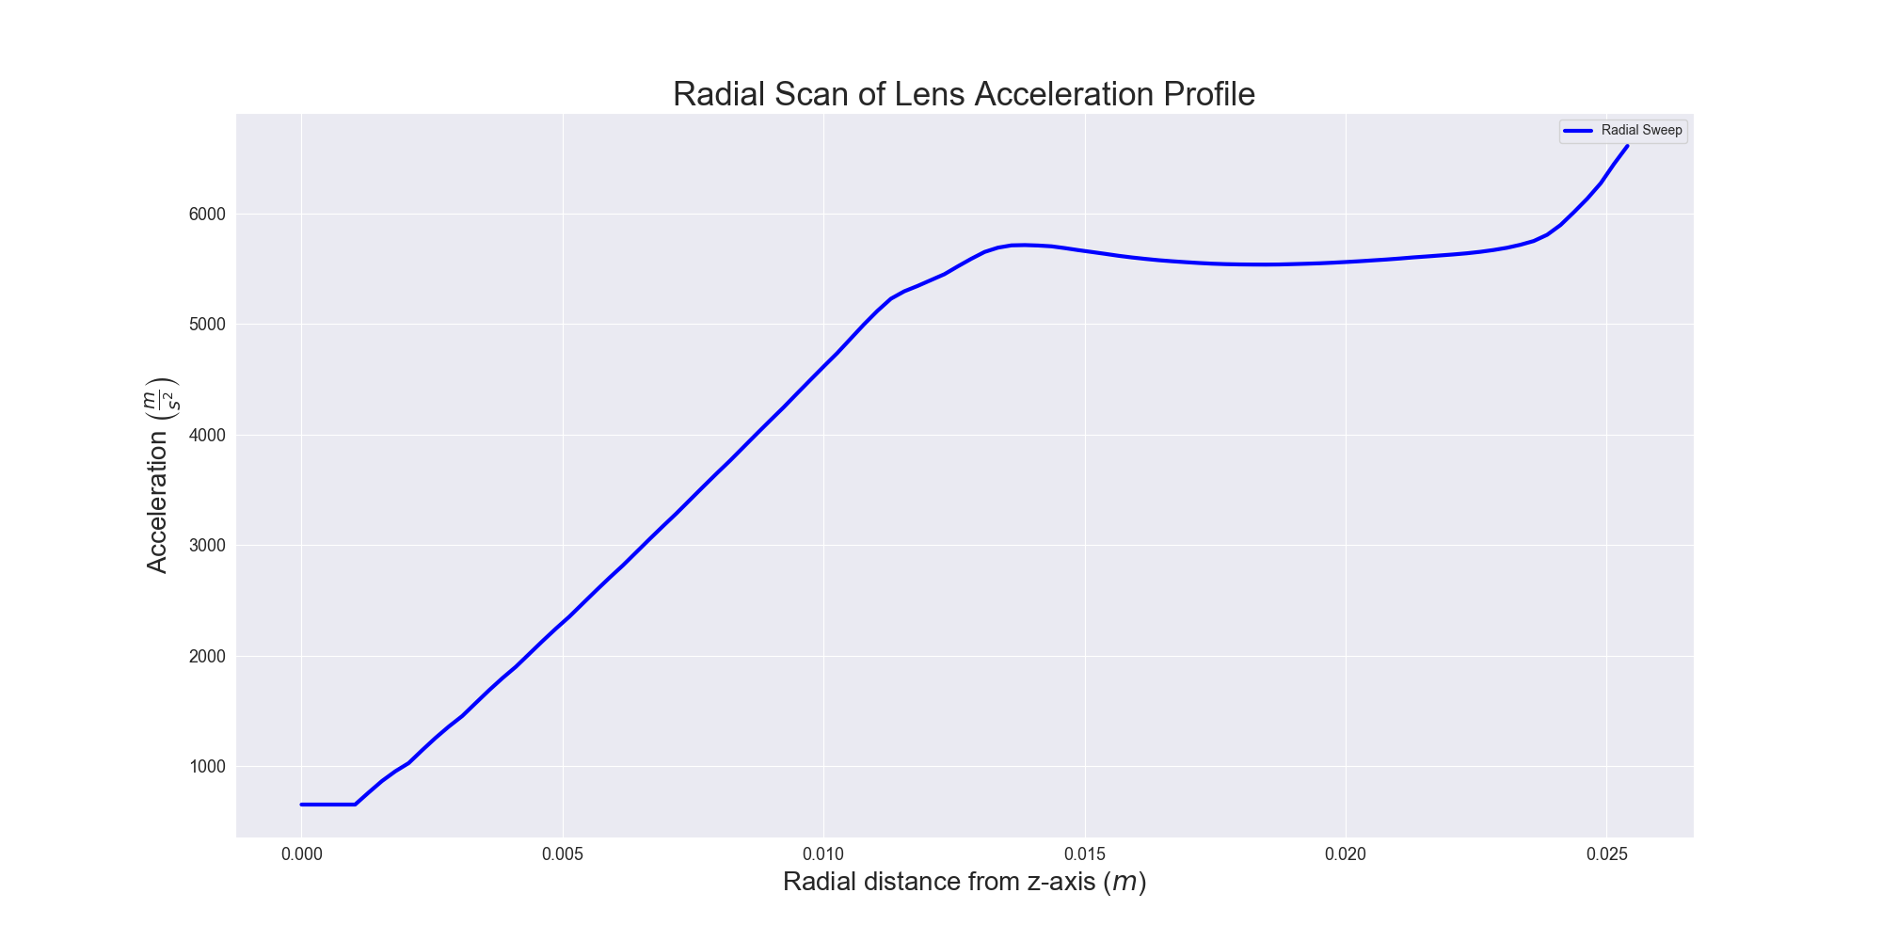

Slide 8
Experimental Setup: Double Lens
4K Aperture,
1 cm
Beam Shutter,
1.4 cm
2.54 cm
2.54 cm
Cell
10 cm
Varied
Lens
Varied
Lens
20 cm
MOT Region

Slide 9
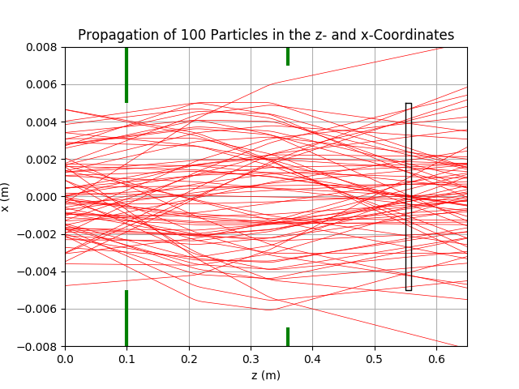
Double Lens: Preliminary Results
Yield ratio: quite high, number enhancement hovers around ~2x that of without any magnetic lens
Still need to generate full heatmap with 2D scan, pipeline WIP

Slide 10
In The Works
Further Tune-Ups
Double Lens Scan with 2 successive lenses
Zeeman-Sisyphus
Simple analytical form of B-field
Accurate B-field model, spin sign change with optical pumping → slowing

Slide 11
Experimental Setup: Zeeman-Sisyphus Preliminary
4K Aperture,
1 cm
Beam Shutter,
1.4 cm
2.54 cm
Cell
10 cm
30 cm
Lens
32 cm
MOT Region
Constant Deceleration

Slide 12
Halbach Cylinder
Leverages Halbach Array
Specifically, a Halbach cylinder
Confined magnetic field
Attenuated outside the magnet
Hexapole configuration of of 12 permanent 1T magnets
Uniformly magnetized, spatially rotating magnetic field
Mathematica, used Radia magnetostatics package
ESRF

